Slide 1
Memory Hierarchy optimization
Prepared by: Shafia Hussain

Slide 2
Basic Cache Optimization
Larger block size to reduce miss rate
Increases spatial locality by reducing compulsory misses
But can also increase capacity and conflict misses
So a complex tradeoff that depends upon cache size and miss penalty
Bigger caches to reduce miss rate
Reduce capacity misses
But increases hit time because more time required to access the block
Also increases both static and dynamic power
Higher associativity to reduce miss rate
Decreases conflict misses
Increases hit time because more circuitry e.g. multiplexer.

Slide 3

Basic Cache Optimization
Multilevel caches to reduce miss penalty
Make first level cache small to reduce hit time
Second level cache with large size, large blocks and high associativity to reduce misses
Giving priority to read misses over writes to reduce miss penalty
Data to be written to memory goes through write buffer in write-back cache.
On a read request first Write buffer is checked to see if there is no hazard (WAR memory hazard)
If there is no hazard then read is allowed to proceed giving it priority over write
Avoiding address translation during indexing of the cache to reduce hit time
The address that a processor generates is virtual address which is different from the actual address in memory called physical address
Virtual address space is much larger than actually memory present e.g 64-bit address space means 16 exabytes = 1 billion gigabytes
So in order to access from memory the virtual address is converted to physical address
To reduce the hit time the data from cache is accessed using the virtual address.
This puts limit to the size of cache

Slide 4
Advanced Cache Optimization
The average memory access formula gives us 3 metrics for cache optimization
hit time
miss rate
miss penalty
Given the recent trends we also add
Cache Bandwidth
Power Consumption

Slide 5
Advanced Cache Optimization
We can classify the ten advanced cache optimizations we examine into five categories based on the metrics discussed earlier
Reducing the hit time
Small and simple first-level caches and way-prediction.
Both techniques also generally decrease power consumption
Increasing cache bandwidth:
pipelined cache, multibank and non-blocking cache
Reducing the miss penalty
Critical word first and merging write buffers.
These optimizations have little impact on power
Reducing the miss rate
Compiler optimizations. Improves power consumption.
Reducing the miss penalty or miss rate via parallelism
Hardware prefetching and compiler prefetching. Generally increase power consumption , primarily because of prefetched data that are unused.

Slide 6
First Optimization: Small and Simple First-Level Caches to Reduce Hit Time and Power
Small size and lower associativity both result in reduced hit time and power consumption
CAD tools are available which tell the access time and power consumption of different cache structures.
The cache hit is the three-step process
Addressing the tag memory using the index portion of the address,
Comparing the read tag value to the address
Setting the multiplexor to choose the correct data item (for set associative).
Another factor which affects the power consumption is the no. of blocks, because it determines the number of “rows” that are accessed
No. of blocks can be reduced by increasing block size but it will increase miss rate.
In recent designs, however there are multiple factors that have led to the use of higher associativity in first-level caches despite the energy and access time costs .e.g. many processors take at least 2 clock cycles to access the cache and thus the impact of a longer hit time may not be critical

Slide 7
Access Time Vs Associativity
Figure 2.8 from the Text Book, 6th Edition

Slide 8
Cache size and associativity vs Energy consumption

Slide 9
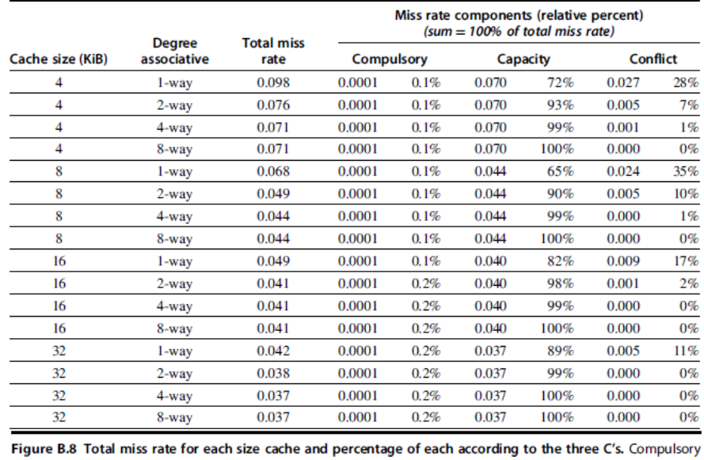

Slide 10
Example
According to Figure 2.8, the access time of 32kb 2-way set associative cache is 1.25 microseconds while for 4-way set associative it is 1.75 microseconds.
1.75/1.25 = 1.4
Consider CCT = 1.24 microseconds

Slide 11
Solution
= 1.4 + 0.037 *15 = 1.955

Slide 12
Second Optimization: Way Prediction to Reduce Hit Time
First used in MIPS R10000 with 2-way set associative cache
Set associative caches have lower miss rate then direct mapped caches but their access time is greater.
Reason is that multiple tags have to be compared and then a multiplexer selects one block from multiple available
With way prediction each block contains predictor bits which tell which way (i.e block in a set) to access in the next access.
So for a 2-way set associative way prediction bits required is 1
If there is a hit we get the access time of a direct mapped cache.
If the prediction is wrong, it updates the predictor bits and compares tags of other ways
Simulations suggest that set prediction accuracy is in excess of 90% for a two-way set associative cache and 80% for a four-way set associative cache, with better accuracy on I-caches than D-caches.

Slide 14
Third Optimization: Pipelined Access and Multi-banked Caches to Increase Bandwidth
In modern processors clock rate 14is high and a hit also takes multiple cycles.
By pipelining the cache, latency is increased but throughput is also increased.
Accessing data from cache has multiple steps. For example, a read operation requires address decoding to select the requested block, read tag, compare it and send the requested data.
By pipelining the clock frequency can be increased.
Many superscalar processors can issue and execute more than one memory reference per clock .
To handle multiple data cache accesses per clock, we can divide the cache into independent banks, each supporting an independent access.
Multiple requests can be issued in a cycle if they access to different banks.
A simple mapping could be sequential interleaving.
Multibanking also reduces power consumption due to decrease in dynamic power

Slide 16
Fourth Optimization: Nonblocking Caches to Increase Cache Bandwidth
In blocking cache, when a miss occurs, instruction execution stops until the data is fetched i.e we cannot issue anymore load data instruction.
Non blocking cache provides subsequent cache accesses in spite of a miss already occurred
Hit under miss: If there is another miss after first miss, processor is stalled
Miss under miss: Supports multiple misses
Two types of misses
Primary miss: the first miss to a cache block. This miss will initiate a fetch request to the higher levels of the memory hierarchy.
Secondary miss: subsequent miss to a cache block that is already being fetched due to a previous primary miss

Slide 17
Example
Example 4.1 (Parallel Computer Design & Organization)
Comparison between a blocking and non-blocking cache To compare the throughput of a blocking and a non-blocking cache, consider the following micro-benchmark
TOY: LW R1,0(R2)
ADDI R2,R2,#4
BNE R2,R4,TOY
The cache has infinite size, has a block size of 16 bytes (four words), and is initially empty. The processor is fast enough such that the load/store queue is always full and addresses are always available so that there is always a load instruction ready to issue to cache in every cycle.

Slide 18
Example Continued
Consider first a blocking cache in which a hit takes one clock and a miss takes 200 clocks(including the initial access to check the cache). The timing diagram for the execution is shown in Figure. Each miss takes 200 cycles and is followed by three hits each taking one. Each execution of the loop roughly takes 50 clocks

Slide 19
Example Continued
Now assume that the cache is lockup free with 16 MSHRs (Miss Status/Handler Registers) so that it can service cache hits while up to 16 (primary and secondary) misses are pending. The timing diagram is shown in Figure ; P and S point to the cycle when a primary or secondary miss occurs and is returned. The same pattern repeats every 200cycles. Every 200 cycles, 16 loads are executed. The block size here is equal to 4 words
instructions stalled after 16 misses

Slide 20

Example
The transfer rate is 16GB/s. Block size is 64, so 16GB/64 = 250M references/second
So new memory blocks are referenced at a rate 250M /second.
During a miss it takes 36ns to access from main memory
In 36ns 250M*36n = 9 references. (These are 9 primary misses i.e. element of new block).
So if 9 misses can be handled, we can keep on executing data access instructions and processor wont stall.
If there is collision in memory i.e. we access successive elements from same memory bank, then it has to wait because there is bank busy time (refresh). Interleaving only hides latency if successive accesses are spread over banks.
If collision chance is 50%, then outstanding references 18 should be supported

Slide 21
Example
Hit under one miss reduces the average data cache access latency( miss rate*miss penalty) to 87.5% of a blocking direct mapped cache for floating point programs and for integer programs it is reduced to 91% of a blocking direct mapped cache

Slide 22
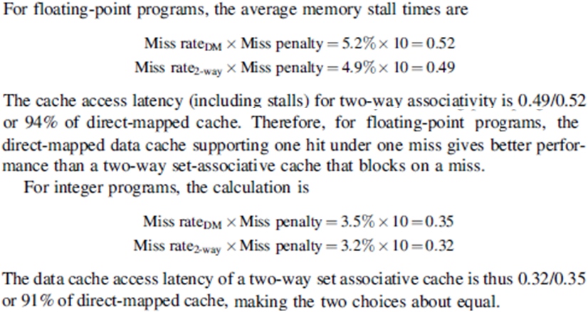
Solution

Slide 23
Fifth Optimization: Critical Word First and Early Restart to Reduce Miss Penalty
Critical word first—Request the missed word first from memory and send it to the processor as soon as it arrives; let the processor continue execution while filling the rest of the words in the block.
Early restart—Fetch the words in normal order, but as soon as the requested word of the block arrives send it to the processor and let the processor continue execution.
Useful only when block size is large

Slide 24
Sixth Optimization: Merging Write Buffer to Reduce Miss Penalty
Write-through caches rely on write buffers, as all stores must be sent to the next lower level of the hierarchy.
if the address of the new data to be written matches the address of a valid write buffer entry, it is merged.
In the example, the data occupies separate entries in a non-merging write buffer as the write to buffer were sequential and there was no merging mechanism
With merging they all occupy a single entry.
So if memory system supports writing multiple words, we will see a speedup.
Without write merging the empty entries in upper figure will only be used if processor writes multiple words at a time

Slide 26
Seventh Optimization: Compiler Optimizations to Reduce Miss Rate
Loop Interchange
Consider code for a row major array

Slide 27
Eighth Optimization: Compiler Optimizations to Reduce Miss Rate: Blocking
This optimization improves temporal locality to reduce misses
When dealing with multiple arrays where some arrays are addressed by rows and others by column
Blocked algorithms operate on submatrices or blocks.
The goal is to maximize accesses to the data loaded into the cache before the data are replaced

Slide 28
Example: Matrix Multiplication Without Blocking
Consider a Fully Associative Cache to ignore Conflict Misses
Assume Cache uses Write Allocate Policy for Write Miss i.e Blocks to be written is brought to cache.
Assume all the matrices are saved in row major order.

Slide 29
Example: Matrix Multiplication Without Blocking
Following is the details of memory access for the multiplication operation
For each value calculation a row of y and a column of z is required. But z is saved in row major order so N rows are read.
If cache is large enough (which is difficult) so that Complete z matrix ,one row of y matrix and one row of x can fit in the cache then for the first calculation all z matrix is brought to cache and the current row of x and y.
Further misses will only occur when next rows of x and y are brought and there will be no misses for z later

Slide 30
Example: Matrix Multiplication Without Blocking
Since cache cannot have such large block size and also no of blocks are also limited.
For z matrix, for each product a new row is brough
If the no’ of blocks in cache are less than N; then by the time next column is required for multiplication, the previous ones are replaced so spatial locality is not used.
So for an NxN matrix, z will give NxN misses for each row computation of x, and in total N³ misses
For y matrix, there can be slight spatial locality, but if block size is small then all row cannot reside in cache
So the no of misses for each row will be N/B, where B is block size of cache.
For each row computation of x, the row of y are read N times and if the cache capacity is limited so that previous fetches are replaced then there will be N²/B misses for each row
So in total for N rows there will be N³/B misses for y.
For x matrix the no. of misses will be N/B misses for each row and N rows there will be N²/B misses

Slide 31
Example: Matrix Multiplication Without Blocking
X = Y*Z

Slide 32
Example: With Blocking
Utilize max temporal locality for z matrix
B is equal to block size of cache such that BxB matrix and one row of x and y matrix can stay in cache.

Slide 33
Example: With Blocking
Utilize max temporal locality for z matrix
B is equal to block size of cache such that BxB matrix and rows of x and y matrix can stay in cache.
For z matrix, B accesses are done and then a BxB block resides in cache which is reused.
The no of BxB blocks read are N²/B², so in total B* N²/B² = N²/B memory accesses for z.
For y matrix N accesses are made to memory to read a row of size B and this process is repeated N²/B² times. The total access made are N³/B² times.
For x matrix also there will be N³/B² accesses

Slide 34
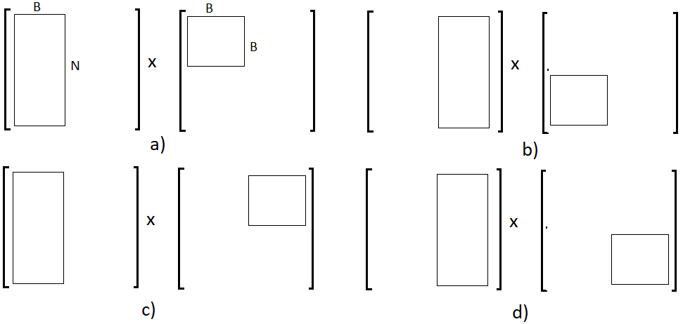
Example: With Blocking
For B=N/2

Slide 35
Ninth Optimization: Hardware Prefetching of Instructions and Data to Reduce Miss Penalty or Miss Rate
Fetch items before the processor requests them.
Either directly into the caches or into an external buffer that can be more quickly accessed than main memory
Both instructions and data can be prefetched,
Typically, the processor fetches two blocks on a miss: the requested block and the next consecutive block.
Prefetching relies on utilizing memory bandwidth that otherwise would be unused, but if it interferes with demand misses it can actually lower performance.

Slide 36
Tenth Optimization: Compiler-Controlled Prefetching to Reduce Miss Penalty or Miss Rate
Like hardware-controlled prefetching, the goal is to overlap execution with the prefetching of data
Prefetch load instructions are added. There are two flavors of prefetch:
Register prefetch loads the value into a register.
Cache prefetch loads data only into the cache and not the register.
Could be faulting or non-faulting. A faulting prefetch can cause a page fault
Non-faulting prefetch instructions convert to nops on page fault

Slide 37
Example
For the code below, determine which accesses are likely to cause data cache misses. Next, insert prefetch instructions to reduce misses. Finally, calculate the number of prefetch instructions executed and the misses avoided by prefetching. Let’s assume we have an 8 KB direct-mapped data cache with 16-byte blocks, and it is a write-back cache that does write allocate. The elements of a and b are 8 bytes long since they are double-precision floating-point arrays. There are 3 rows and 100 columns for a and 101 rows and 3 column for b (although we are accessing just 1). Ignore conflict misses
Solution
For b array first iteration will miss for b[j],b[j+1] and rest 99 iterations for b[j+1]. So total 2+99=101 misses. Later on b will reside in cache
For a array, for each j loop there will be 100/2=50, because when 1 block consists of 2 elements, so 50% hits. Total 50*3=150

Slide 38
Example (continued)
Assume prefetch is done for 8th element onwards and also we don’t have to worry about suppressing the prefetches at the end which go beyond ‘a’ and ‘b’.

Slide 39
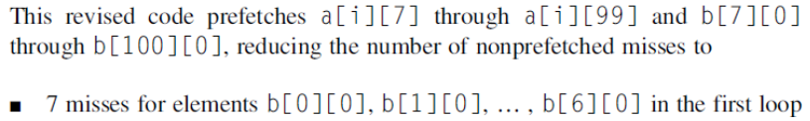
Example (continued)
Consider a[]. On each j loop misses will be for a[0],a[2],a[4],a[6]. So total 12 for a[]

Slide 40
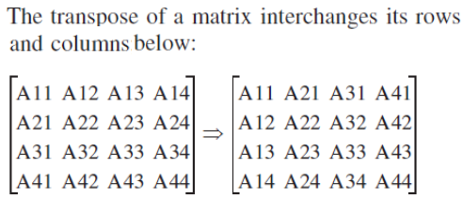
Exercise
It is required to compute transpose of a matrix

Slide 42
Solution
To max utilize Temporal and spatial locality cache must be able to hold both matrices of size BxB. Since Block size is 8 elements. So number of blocks is 8+8=16. So 16*64bytes
Assume input array is accessed in rows while ouput in columns. For unblocked version.
Input Array
There are misses after every 8 elements. So no. of misses in a row is 256/8 = 32 misses
For 256 rows, misses = 256*32= 2¹³
Output array
There will be miss for each element. So total 256*256= 2¹⁶
So, total misses for unblocked = 2¹³+2¹⁶
For Blocked version
For each array there will be B misses for each block. After that both blocks will remain in cache till they are completely used. Total blocks will be N²/B²
So Total Misses= B* N²/B² + B* N²/B² = 2N²/B= 2*256*256/8 = 2¹⁴
Ratio = 2¹³+2¹⁶/ 2¹⁴ = 9/2

Slide 43
Solution
c)
For(i=0;i<N;i=i+B) // Move down to next row of blocks
For(j=0; j<N; j=j+B) //Move to next block in horizontal
for(k=i; k<min(k+B,N) ; k++){ //move to next input row and out column
for (m=j ; m<min(k+B,N) ;m++) //select successive input elements in row
out[m][k]=in[k][m]; }
In the innermost loop elements within a block are selected; successive row elements for input, and column elements for ouput
In the next loop above rows are shifted downwards for input and columns rightward for ouput
In j loop operation is moved to next row block towards right for input, and downward for output
In the outermost loop, operation is moved to next row of blocks for input and next column of blocks for output
For the given scenario. N=256, B=8

Slide 44
Solution
d) Since at most two blocks reside in cache so at max two elements can have an overlapping line in cache. Thus 2-way set associativity is enough

Slide 45
Solution:
Level 2 cache can process a request every 2 cycles (it is pipelined). And we require new value of output array on each iteration because it is accessed in columns.
So if we initiate a prefetch every 2 cycles and it takes 16 cycles for the first to service, we will already have sent 8 more requests until 1st is serviced at 16th cycle. Later at 18, 20, 22 cycles the request will complete but we will also send new request at these cycles. Thus outstanding requests will remain 8

